Slide 1






Web Science - Presentation
by Bence Olay
2021
Data-sets:
Stanford data-set (SST)
Crowdsourcing data (on SST)
Amazon reviews
Programming
language
Framework
Machine Learning
package
Data manager
package
Further progress on
https://github.com/Olaybence/Web-Science

Slide 2
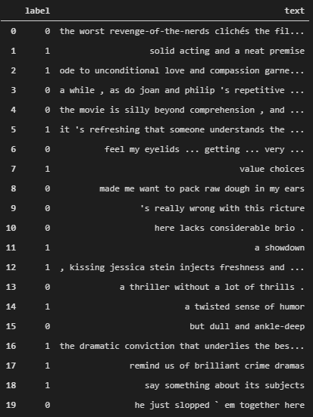
Stanford data-set (SST)

Slide 3
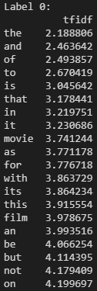
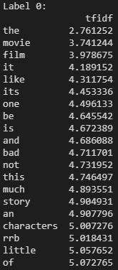
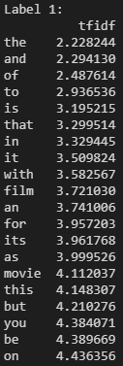
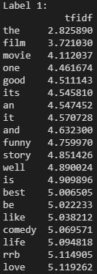
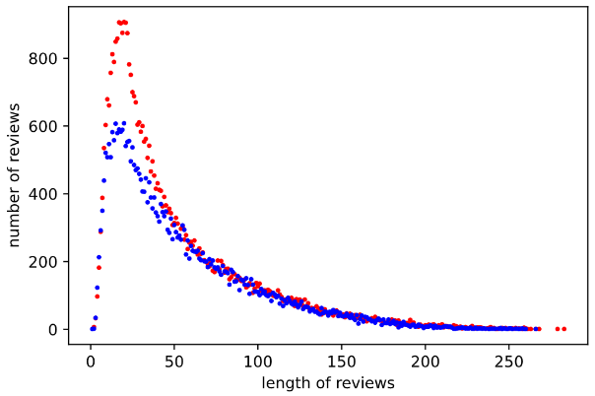
Stanford data-set Rotten Tomatoes review snippets data-set with sentimental labeling
Main focus on regarding optimization:
Preprocessing → Better vocabulary
What to remove?
Conjunction words, stopwords, etc.
How to remove?
Substrings
Together different meaning (negative words)
Focus on removing meaningless frequent words
Off-the-shelf dictionaries from nltk.corpus import stopwords
Create custom from the most frequents

Slide 4
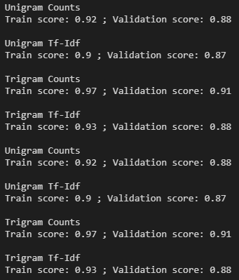
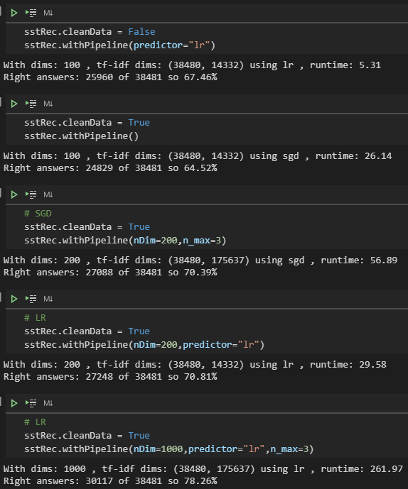
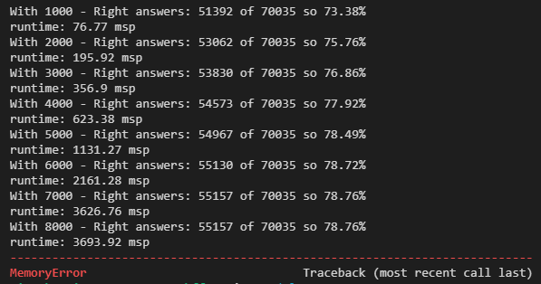
Parameters & Runtime
Using higher n-grams
Prepositions captured
Phrases with different meaning
Slows down training
Higher dimensional representation (tf-idf mtx)
More precise
More memory usage
Slows down training
Analyze parameters and performance
Off-the-shelf models Gensim , Word2Vec Depending on the subject (How specific)
Testing parameters
Predictor, repres. dimension
N-gram
Training runtime – „With Dim.”

Slide 5
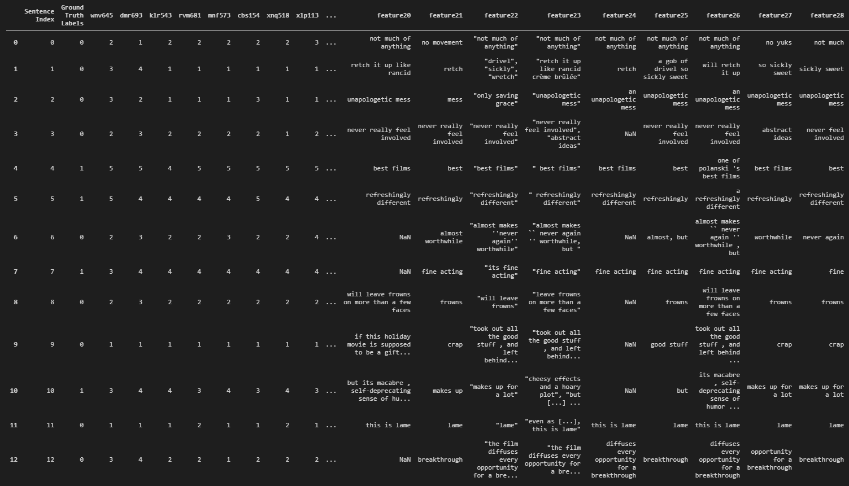
Crowdsourcing data

Slide 6
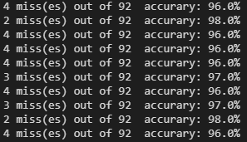

Crowdsourcing collaborative labeling the reviews part of SST
My own solution: (Decide together)
Rating trust with minimum trust
Recalculating the trusts
Scale-rate reduction
Train classifier
The other usecase: (Predict unknown)
Transform data
Label all the same or one-by-one?
Preprocess
Were they smart enough?
Vocabulary
Trained Classifier
Own approach
with trust-rate

Slide 7
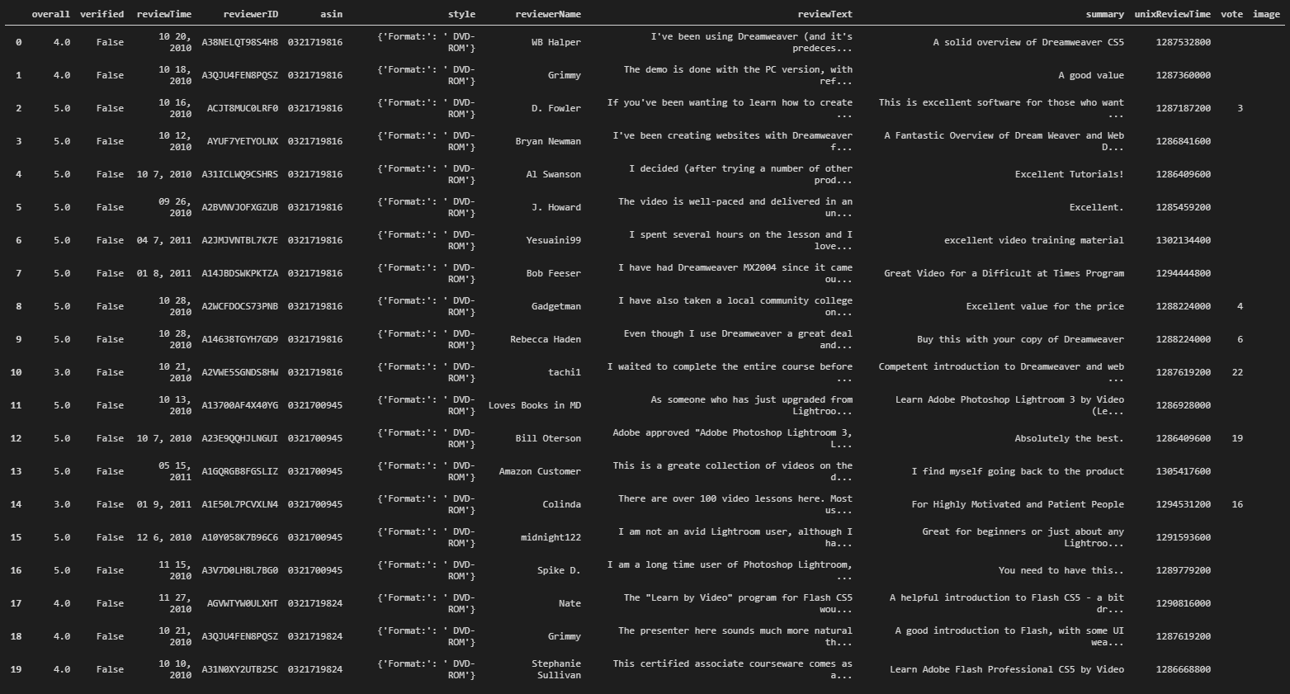
Amazon Reviews

Slide 8

Amazon reviews product reviews
Data details:
Users avg. number of ratings: 7
Products avg. number of ratings: 16
Recommendation:
Similarity score
Using given product → only who reviewed
Similar products
K-nearest neighbor
Improvements in recommendation:
Group by products
Combine with Context-based Recommendation as at SST
Summary, Review text
Scorings with 3 factors: paper
Proximity – distance between two ratings
Simularity – how much different they are at the given item
Significance – two ratings are more distant from the median (outliners)
Recommendation by similarity score

Slide 9
Thank you for your attention!

